Slide 1
Introduction to Cryptography and Network Security Md. Alamgir Hossain Senior Lecturer, Prime University Mail: alamgir.cse14.just@gmail.com YouTube: https://www.youtube.com/alamgirhossaincse

Slide 2

Why need Cryptography??
But is internet system secure??
The message can be corrupted by intruders/third party.
To provide the security and protect the valuable information we can use Cryptography.
Sender
Internet
Receiver
How are you??

Slide 3
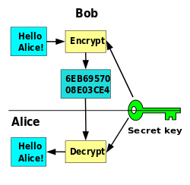
What is Cryptography??
Bob wants to send a message to Alice.
His message can be sent securely by transforming the whole content into a new form others can’t understand.
(Hello Alice→6EB6957008E03CE4)
The art of protecting information by transforming into an unreadable format is called Cryptography.

Slide 4
Encryption and Decryption
Encryption: Is the process of transferring information from readable format to unreadable format.
Decryption: Is the process of transferring information from unreadable format to readable format.
Key: A string of bits used by a cryptographic algorithm which is used to transform plaintext into cypher text or vice versa. Key remains private and secures communication.

Slide 5
Security
Network Security - measures to protect data during their transmission
Internet Security - measures to protect data during their transmission over a collection of interconnected networks

Slide 6
Network Security

Slide 7

Normal Flow of Data over a Network
Receiver
Sender

Slide 8
Possible Attack (Interruption)
Interruption: services or data become unavailable, unusable, destroyed, and so on, such as lost of file, denial of service, etc.
Cut wire lines,
Jam wireless signals,
Drop packets,

Slide 9

Possible Attack (Interception)
Interception: an unauthorized subject has gained access to an object, such as stealing data, overhearing others communication, etc.
Wiring, eavesdrop

Slide 10
Possible Attack (Modification)
Modification: unauthorized changing of data or tempering with services, such as alteration of data, modification of messages, etc.
Replaced info
intercept

Slide 11
Possible Attack (Fabrication)
Fabrication: additional data or activities are generated that would normally no exist, such as adding a password to a system, replaying previously send messages, etc.

Slide 12
Aspects of Security
Security attack
Security mechanism
Security service

Slide 13

Security Attacks
Any action that compromises the security of information owned by an organization.
Information security is about how to prevent attacks or failing that, to detect attacks on information-based systems
Can focus of generic types of attacks
Passive
Active

Slide 14
Security Attacks
Any action that compromises the security of information owned by an organization.
Information security is about how to prevent attacks or failing that, to detect attacks on information-based systems
Can focus of generic types of attacks
Passive
Active

Slide 15
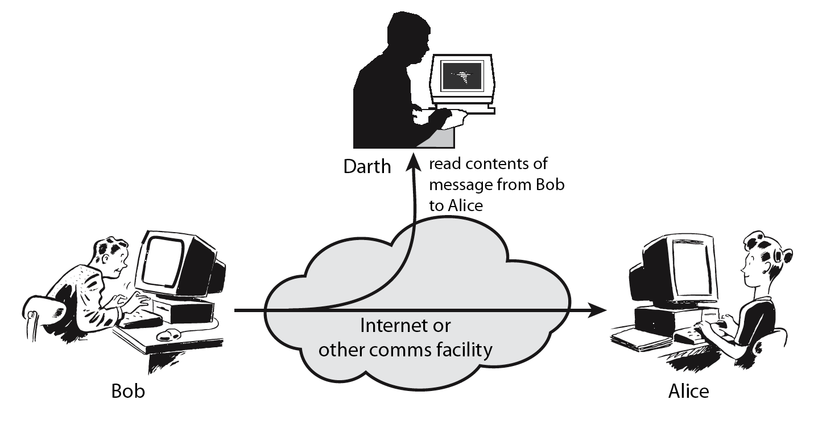
Passive Attacks
A passive attack attempts to learn or make use of information from the system but does not affect system resources.

Slide 16
Types of Passive Attacks

Slide 17
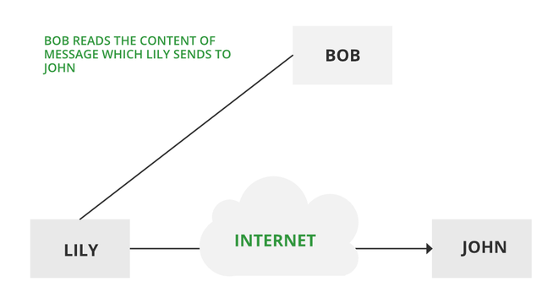
Release of Message Content
Telephonic conversation, an electronic mail message, or a transferred file may contain sensitive or confidential information.
We would like to prevent an opponent from learning the contents of these transmissions.

Slide 18
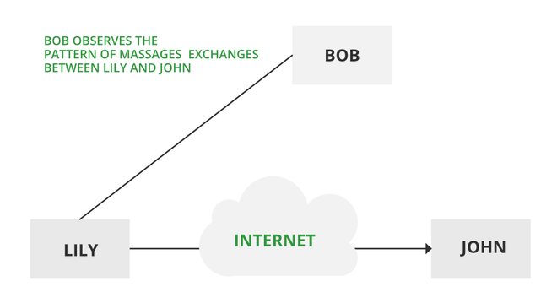
Traffic Analysis
Suppose that we had a way of masking (encryption) information, so that the attacker even if captured the message could not extract any information from the message.
The opponent could determine the location and identity of communicating host and could observe the frequency and length of messages being exchanged. This information might be useful in guessing the nature of the communication that was taking place.

Slide 19
Active Attacks
An active attack attempts to alter system resources or affect their operations.
Active attacks involve some modification of the data stream or the creation of false statements.
Types of active attacks are as follows:
Masquerade
Modification of messages
Repudiation
Replay
Denial of Service

Slide 20
Types of Active Attacks

Slide 21
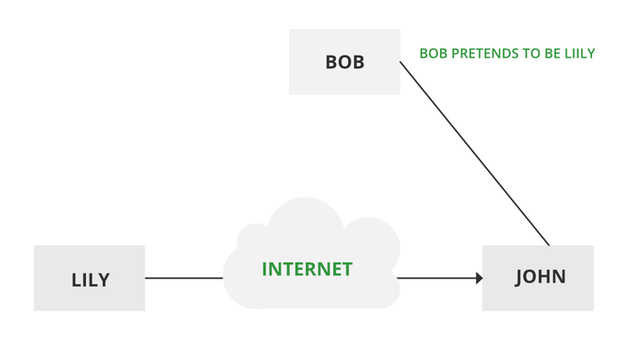
Masquerade
A masquerade attack takes place when one entity pretends to be a different entity.

Slide 22
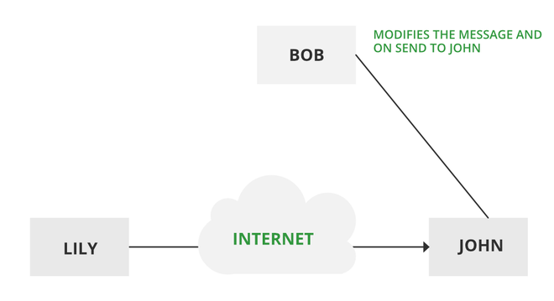
Modification of Messages
It means that some portion of a message is altered or that message is delayed or reordered to produce an unauthorized effect.

Slide 23
Repudiation
This attack occurs when the network is not completely secured or the login control has been tampered with.
With this attack, the author’s information can be changed by actions of a malicious user in order to save false data in log files, up to the general manipulation of data on behalf of others, similar to the spoofing of e-mail messages.

Slide 24
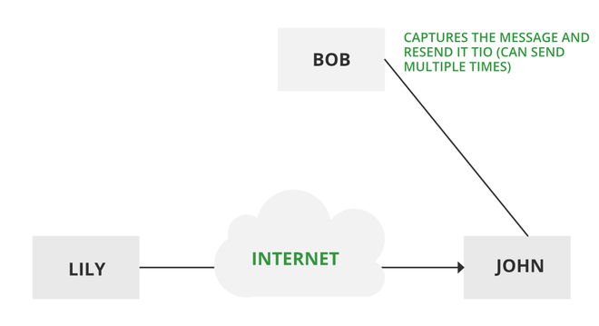
Replay
It involves the passive capture of a message and its subsequent transmission to produce an authorized effect.

Slide 25
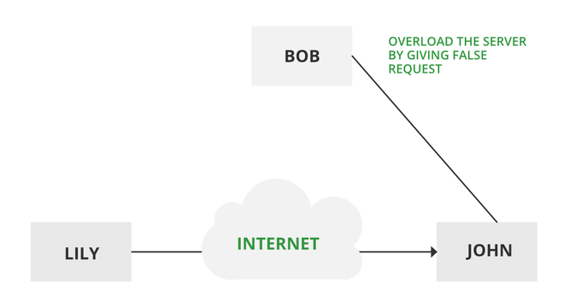
Denial of Service
It prevents the normal use of communication facilities. This attack may have a specific target.

Slide 26
Cryptography and Network Security Principles/Services

Slide 27
Confidentiality
The principle specifies that only the sender and receiver will be able to access the information shared between them.
Confidentiality is compromised if an unauthorized person is able to access a message.
For example, let us consider sender A wants to share some confidential information with receiver B and the information gets intercepted by the attacker C. Now the confidential information is in the hands of an intruder C.

Slide 28
Authentication
Authentication is the mechanism to identify the user or system or the entity.
It ensures the identity of the person trying to access the information.
The authentication is mostly secured by using username and password.
The authorized person whose identity is preregistered can prove his/her identity and can access the sensitive information.

Slide 29
Integrity
Integrity gives the assurance that the information received is exact and accurate.
If the content of the message is changed after the sender sends it but before reaching the intended receiver, then it is said that the integrity of the message is lost.

Slide 30
Non-Repudiation
Non-repudiation is a mechanism that prevents the denial of the message content sent through a network.
In some cases, the sender sends the message and later denies it.
But the non-repudiation does not allow the sender to refuse the receiver.

Slide 31
Access control
The principle of access control is determined by role management and rule management.
Role management determines who should access the data while rule management determines up to what extent one can access the data.
The information displayed is dependent on the person who is accessing it.

Slide 32
Availability
The principle of availability states that the resources will be available to always authorized party.
Information will not be useful if it is not available to be accessed. Systems should have sufficient availability of information to satisfy the user's request.

Slide 33
Security Mechanism
Feature designed to detect, prevent, or recover from a security attack
No single mechanism that will support all services required
However one element underlies many of the security mechanisms in use: cryptographic techniques

Slide 34
A basic Encryption and Decryption system
Key
How are you??
How are you??
Bob
Encryption
Algorithm
Decryption
Algorithm
Alice
6Y45HRS810PG7DA8

Slide 35
Thank You

